Slide 1
Block Cipher Modes of Operation

Slide 2
How to use a block cipher?
Block ciphers encrypt fixed-size blocks
  e.g. DES encrypts 64-bit blocks
We need some way to encrypt a message of arbitrary length
  e.g. a message of 1000 bytes
NIST defines several ways to do it
  called modes of operation

Slide 3
Encrypting a Large Massage
Electronic Code Book (ECB)
Cipher Block Chaining (CBC)
Output Feedback Mode (OFB)
Cipher Feedback Mode (CFB)
Counter Mode (CTR)

Slide 4
Message Padding
The plaintext message is broken into blocks, P₁, P₂, P₃, ...
The last block may be short of a whole block and needs padding.
Possible padding:
  Known non-data values (e.g. nulls)
  Or a number indicating the size of the pad
  Or a number indicating the size of the plaintext
  The last two schemes may require an extra block.

Slide 5
Electronic Code Book (ECB)
The plaintext is broken into blocks, P₁, P₂, P₃, ...
Each block is encrypted independently:
C_{i} = E_{K}(P_{i})
For a given key, this mode behaves like we have a gigantic codebook, in which each plaintext block has an entry, hence the name Electronic Code Book

Slide 6
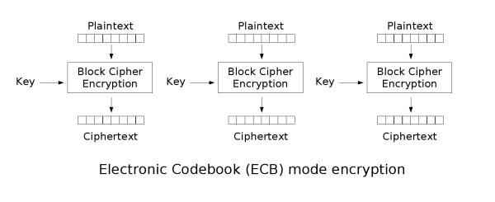
ECB MODE

Slide 7
Remarks on ECB
Strength: it’s simple.
Weakness:
  Repetitive information contained in the plaintext may show in the ciphertext, if aligned with blocks.
  If the same message (e.g., an SSN) is encrypted (with the same key) and sent twice, their ciphertexts are the same.
Typical application: secure transmission of short pieces of information (e.g. a temporary encryption key)

Slide 8
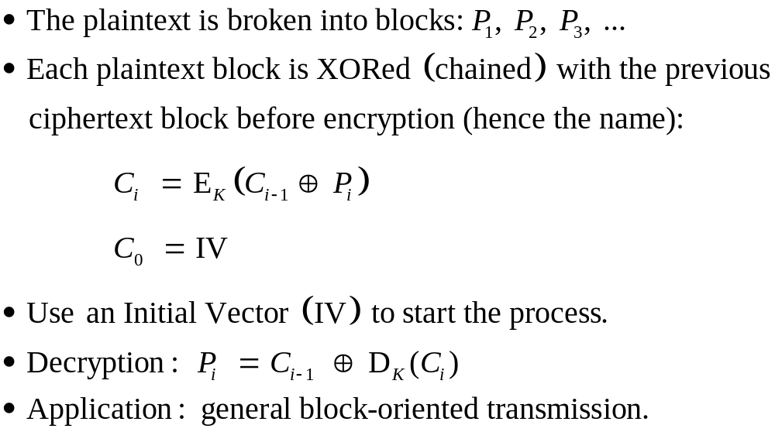
Cipher Block Chaining (CBC)

Slide 9
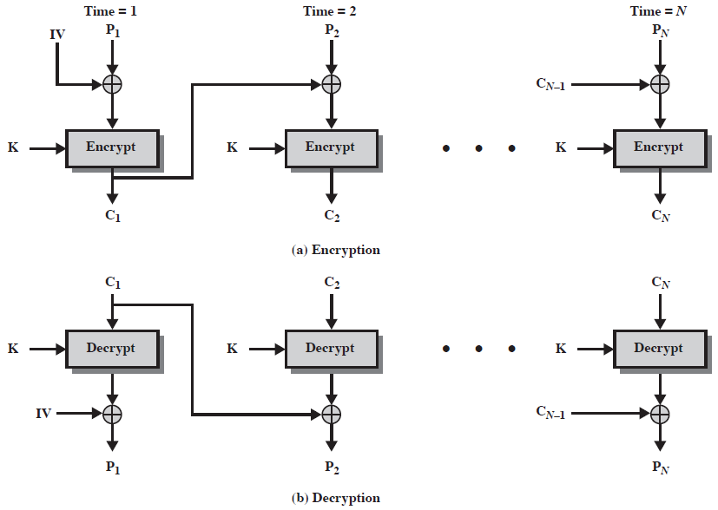
Cipher Block Chaining (CBC)

Slide 10
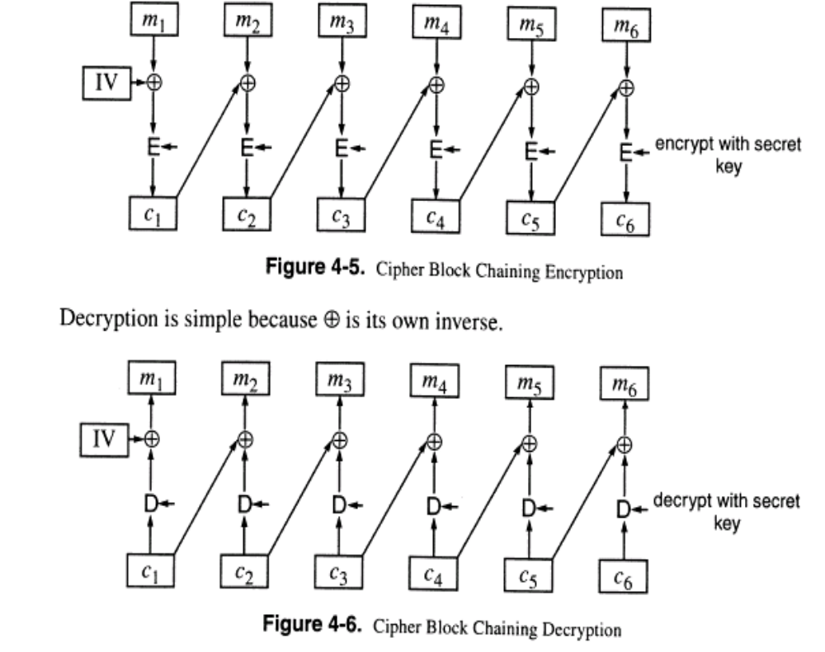

Slide 11
Remarks on CBC
The encryption of a block depends on the current and all blocks before it.
So, repeated plaintext blocks are encrypted differently.
Initialization Vector (IV)
  Must be known to both the sender & receiver
  Typically, IV is either a fixed value or is sent encrypted in ECB mode before the rest of ciphertext.

Slide 12
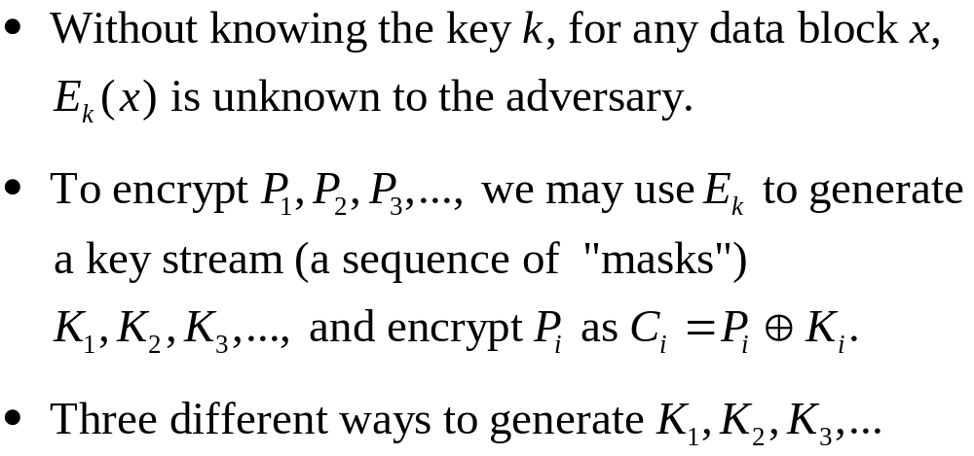

Slide 13
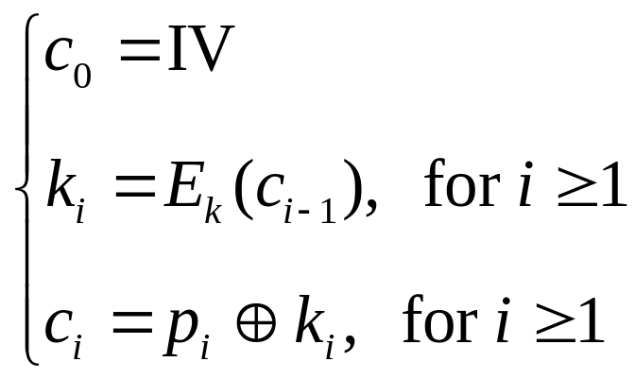
Cipher feedback mode (basic version)
Plaintext blocks: p₁, p₂, …
Key: k
Basic idea: construct key stream k₁, k₂, k₃, …
Encryption:

Slide 14
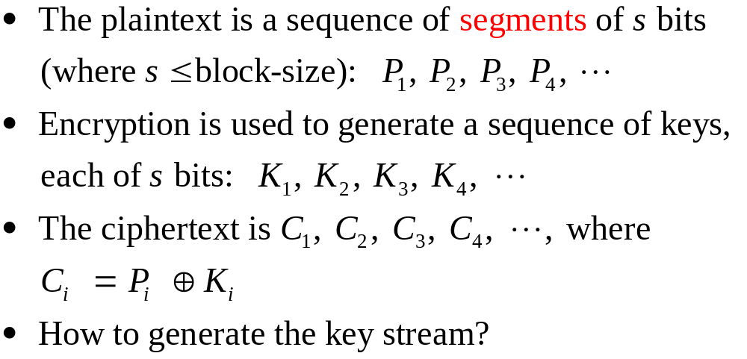
Cipher Feedback (CFB) Mode

Slide 15
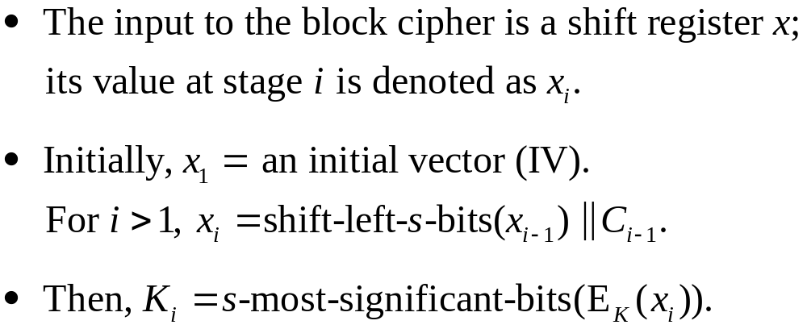
Generating Key Stream for CFB

Slide 16
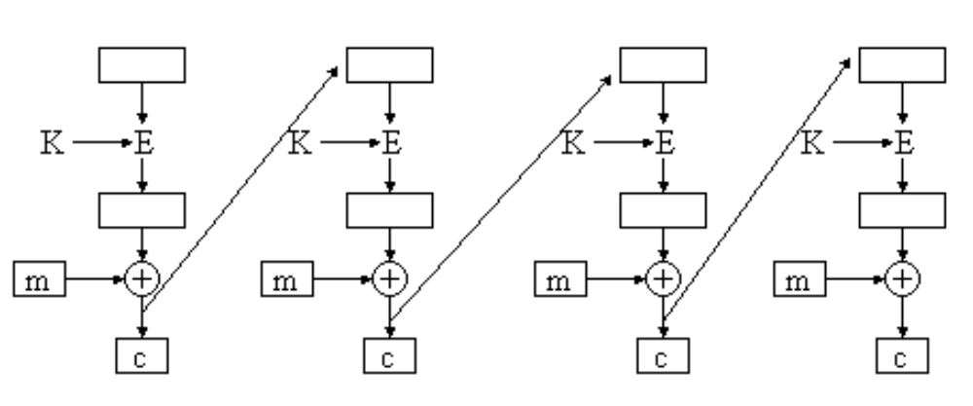
CFB MODE

Slide 17
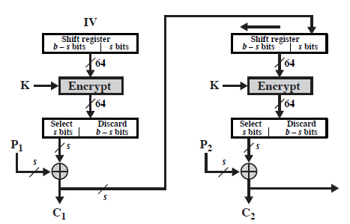
Encryption in CFB Mode

Slide 18
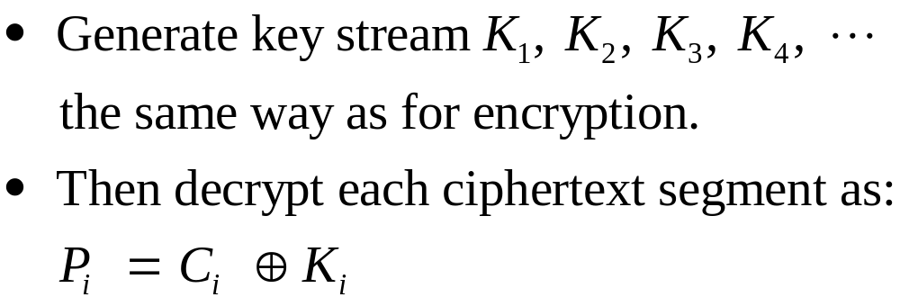
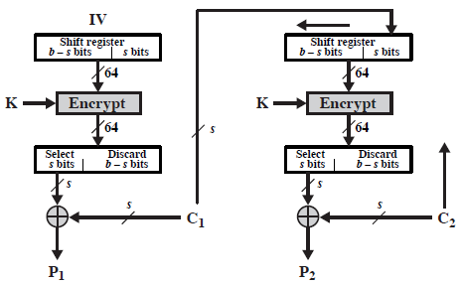
Decryption in CFB Mode

Slide 19
Remark on CFB
The block cipher is used as a stream cipher.
Appropriate when data arrives in bits/bytes.
s can be any value; a common value is s = 8.
A ciphertext segment depends on the current and all preceding plaintext segments.
A corrupted ciphertext segment during transmission will affect the current and next several plaintext segments.
  How many plaintext segments will be affected?

Slide 20
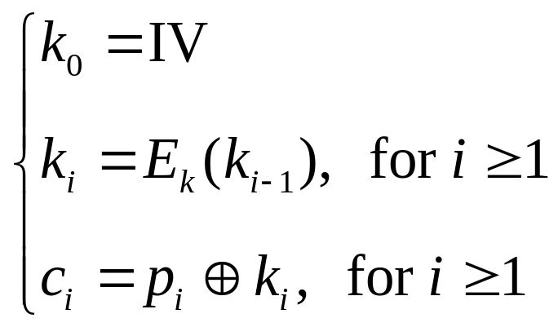
Output feedback mode (basic version)
Plaintext blocks: p₁, p₂, …
Key: k
Basic idea: construct key stream k₁, k₂, k₃, …
Encryption:

Slide 21
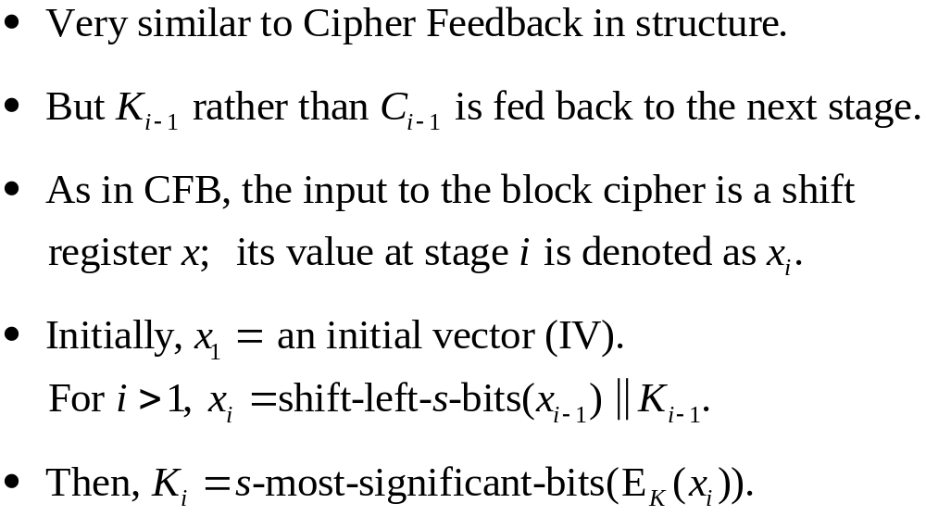
Output Feedback (OFB) Mode

Slide 22
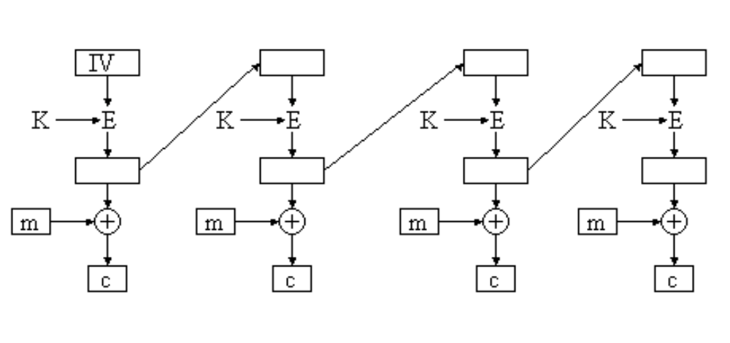
Output Feedback Mode (OFB)

Slide 23
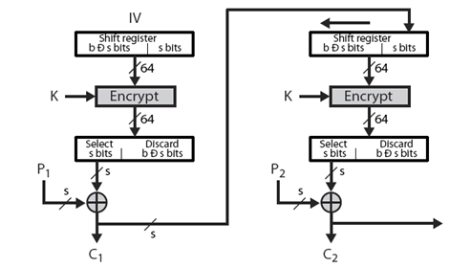
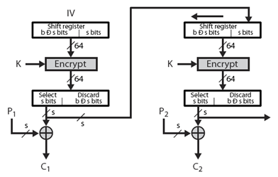
Cipher Feedback
Output Feedback

Slide 24
Remark on OFB
The block cipher is used as a stream cipher.
Appropriate when data arrives in bits/bytes.
Advantage:
  more resistant to transmission errors; a bit error in a ciphertext segment affects only the decryption of that segment.
Disadvantage:
  Cannot recover from lost ciphertext segments; if a ciphertext segment is lost, all following segments will be decrypted incorrectly (if the receiver is not aware of the segment loss).
IV should be generated randomly each time and sent with the ciphertext.

Slide 25
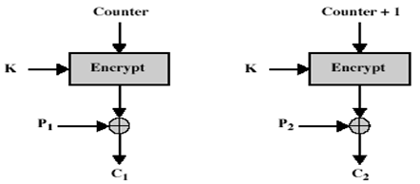
Counter Mode (CTR)
Plaintext blocks: p₁, p₂, p₃, …
Key: k
Basic idea: construct key stream k₁, k₂, k₃, …
Encryption:
  T₁ = IV (random)
  T_{i} = IV + i - 1
  C_{i} = P_{i} ♁ E_{K}(T_{i})
  C = (IV, C₁, C₂, C₃, ...)

Slide 26
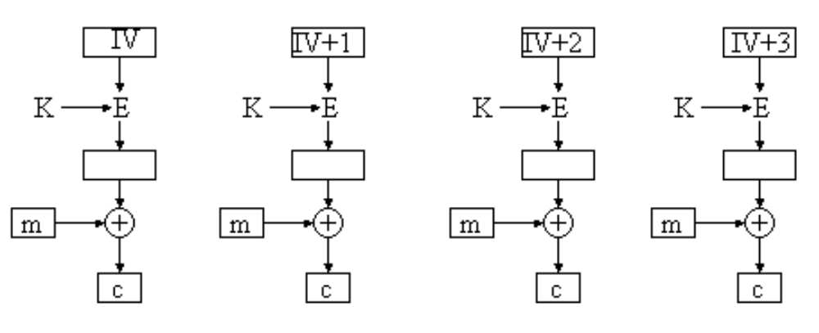
COUNTER MODE

Slide 27
Remark on CTR
Strengthes:
  Needs only the encryption algorithm
  Fast encryption/decryption; blocks can be processed (encrypted or decrypted) in parallel; good for high speed links
  Random access to encrypted data blocks
IV should not be reused.

